Slide 1
Automatically Labeled Data Generation for Large Scale Event Extraction
Yubo Chen, Shulin Liu, Xiang Zhang, Kang Liu, and Jun Zhao
National Laboratory of Pattern Recognition
Institute of Automation, Chinese Academy of Sciences

Slide 2
Outline
Task & Related Work
Our Proposed Approach
Experiments

Slide 3
Outline
Task & Related Work
Our Proposed Approach
Experiments

Slide 4
Task
Event
In Automatic Content Extraction (ACE),
an event is defined as a specific occurrence involving participants.
an event is something that happens
an event can be described as a change of state
Event Extraction
a challenging task in Information Extraction
aims at detecting and typing events and extracting arguments with different roles from natural-language texts.

Slide 5
Task
Terminology
Event mention, Event trigger, Event argument, Argument role
Yesterday , some demonstrators threw stones at soldiers in Israeli.
Yesterday
threw
Israeli
Trigger | Threw(a “Conflict/Attack”event)
Arguments | Role = Attacker | demonstrators
 | Role = Instrument | stones
 | Role = Target | soldiers
 | Role =Time | Yesterday
 | Role=Place | Israeli

Slide 6
Related Work
Supervised Methods
Feature-based method:
Convert classification clues into discrete features
eg.
Local features were used to train the classifier(Ahn 2006)
Global features were used(Ji and Grishman 2008)
Cross-event and Cross-entity inference
(Gupta and Ji 2009, Liao and Grishman 2010, Hong et al.2011)

Slide 7
Related Work
Supervised Methods
Structure-based method
Predicting the structure of the event in a sentence
eg.
Dependency parsing problem (McClosky 2011)
Structured perceptron with beam search(Li et al. 2013)
Constructing information networks(Li et al. 2014)

Slide 8
Related Work
Supervised Methods
Neural-based method
Extracting features from texts automatically.
eg.
CNN based (Nguyen 2015, Chen 2015, Nguyen 2016)
RNN based (Nguyen 2016, Feng 2016)

Slide 9
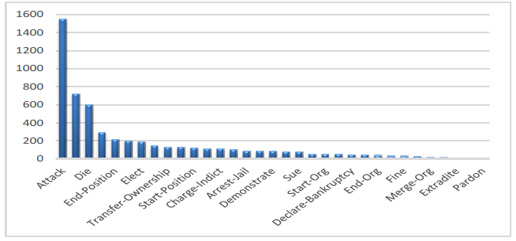
Problems
Supervised methods relies on elaborate human-annotated data. Thus suffer from high costs for manually labeling training data and low coverage of predefined event types .
Unsupervised methods can extract large numbers of events without using labeled data. But extracted events may not be easy to be mapped to events for a particular knowledge base.
Statistics of ACE 2005 English Data.

Slide 10
Motivation
For extracting large scale events, especially in open domain scenarios, how to automatically and efficiently generate sufficient training data is an important problem
Recent improvements of Distant Supervision (DS) have been proven to be effective to label training data for Relation Extraction

Slide 11
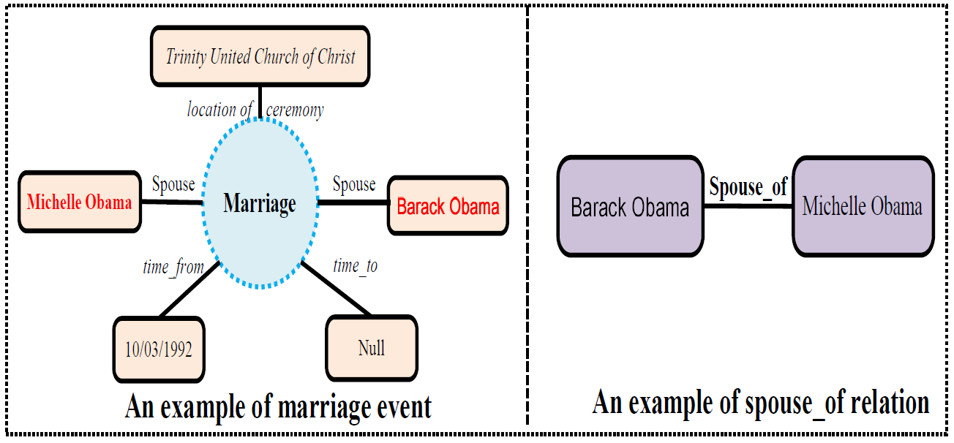
Challenges
Triggers are not given out in existing knowledge bases
RE: ( entity1, relation, entity2)
We can use Michelle Obama and Barack Obama to label back
EE:(event instance, event type; role1, argument1 ;...; rolen, argumentn)
We can not use m.02nqglv and Barack Obama to label back
In ACE, an event instance is represented as a trigger word.

Slide 12
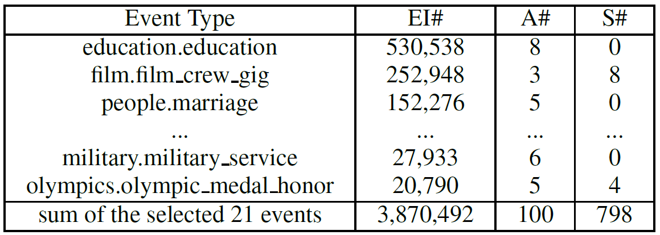
Challenges
Arguments for a specific event instance are usually mentioned in multiple sentences.
Statistics of events in Freebase.
Only 0.02% of instances can find all argument mentions in one sentence

Slide 13
Outline
Task & Related Work
Our Proposed Approach
Experiments

Slide 14
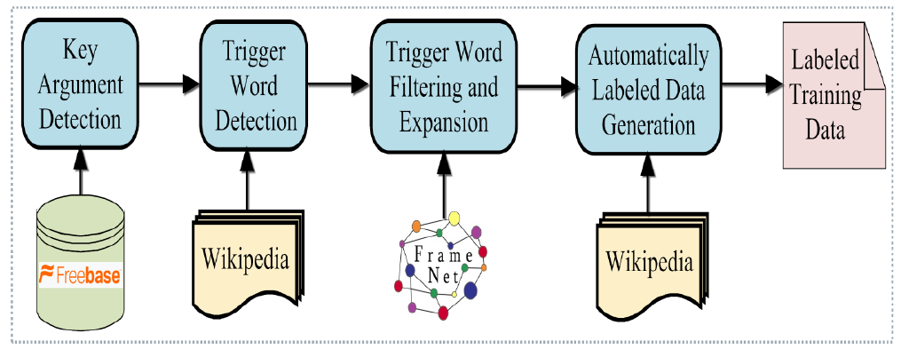
Method of Generating Training Data
The architecture of automatically labeling training data

Slide 15
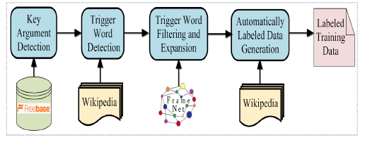
Method of Generating Training Data
Key Argument Detection
Role Saliency (RS): reflects the saliency of an argument to represent a specific event instance of a given event type.
Event Relevance (ER): reflects the ability in which an argument can be used to discriminate different event types.
Key Rate (KR): estimate the importance of an argument to a type of event.

Slide 16
Method of Generating Training Data
Trigger Word Detection
We use key arguments to label sentences that may express events in Wikipedia
Then we use these labeled sentences to detect trigger
Trigger Rate (TR):
Trigger Candidate Frequency (TCF)):
Trigger Event Type Frequency (TETF):

Slide 17
Method of Generating Training Data
Trigger Word Filtering and Expansion
we propose to use linguistic resource FrameNet to filter noisy verbal triggers and expand nominal triggers
The initial trigger lexicon is noisy and merely contains verbal triggers

Slide 18
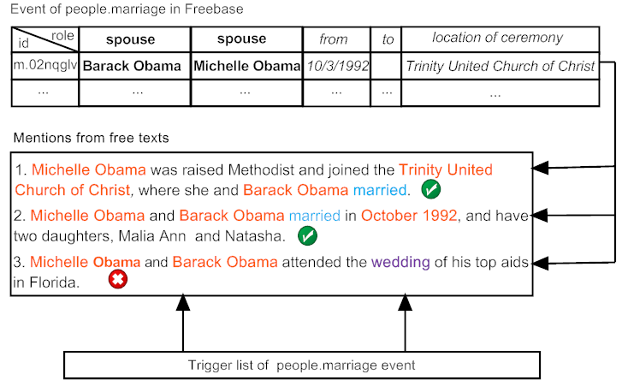
Method of Generating Training Data
Automatically labeled data generation
we propose a Soft Distant Supervision and use it to automatically generate training data

Slide 19
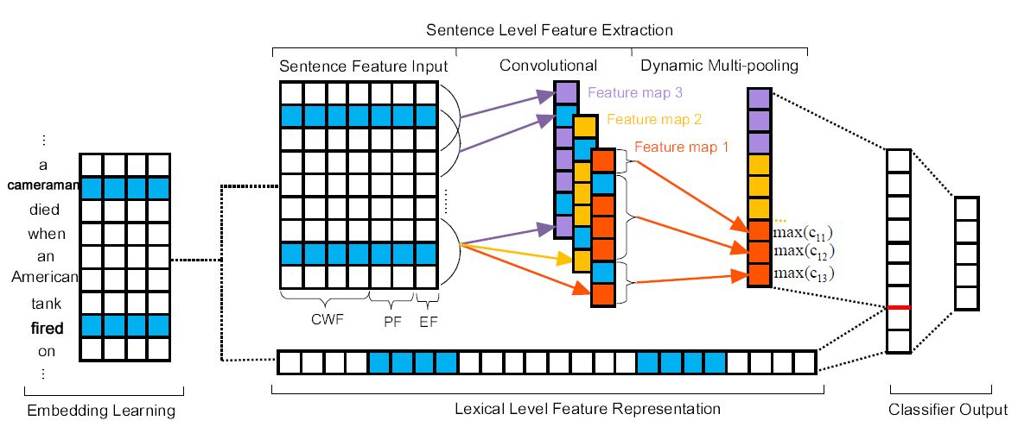
Method of Event Extraction
DMCNN
we use DMCNN as the basic model for event extraction

Slide 20
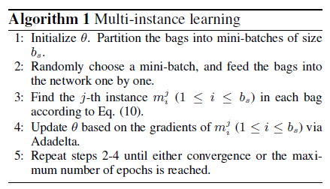
Method of Event Extraction
DMCNN
To alleviate the wrong label problem, we use Multi-instance Learning for DMCNNs
In stage of argument classification, we take sentences containing the same argument candidate and triggers with a same event type as a bag and all instances in a bag are considered independently.

Slide 21
Outline
Task & Related Work
Our Proposed Approach
Experiments

Slide 22
Experiments
Our Automatically Labeled Data
When we merely use two key arguments to label data, we will obtain 421,602 labeled sentences. However, these sentences miss labeling triggers.
When we use two key arguments and trigger words to label data, we will obtain 72,611 labeled sentences.
Compared with nearly 6,000 human annotated labeled sentence in ACE, our method can automatically generate large scale labeled training data.

Slide 23
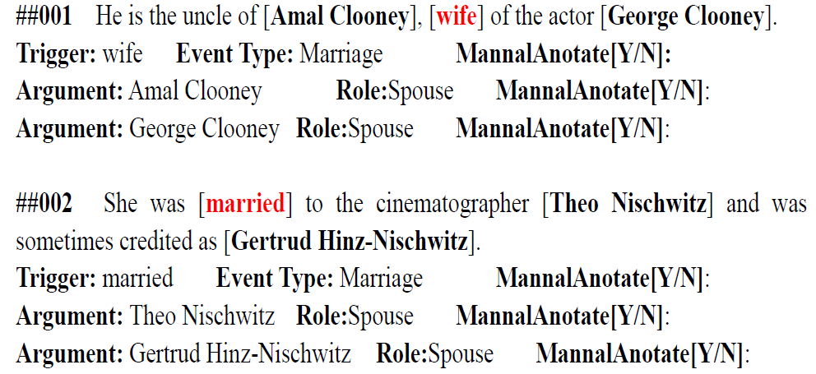
Experiments
Manual Evaluations of Labeled Data
We randomly select 500 samples from our automatically labeled data
Each sample is independently annotated by three annotators

Slide 24
Experiments
Automatic Evaluations of Labeled Data
Data
ACE, Expanded Data (ED), ACE+ED
Evaluation
40 newswire articles from ACE 2005 as test set
30 other documents from different genres as development set
The rest (529) documents for training
A trigger is correct if its event subtype and offsets match those of a reference trigger
An argument is correctly identified if its event subtype and offsets match those of any of the reference argument mentions
An argument is correctly classified if its event subtype, offsets and argument role match those of any of the reference argument mentions
Precision, Recall, F-score

Slide 25
Experiments
Automatic Evaluations of Labeled Data
Compared with all models, DMCNN trained with ACE+ED achieves the highest performance. This demonstrates that our automatically generated labeled data could expand human annotated training data effectively.

Slide 26
Experiments
Automatic Evaluations of Labeled Data
Compared with Chen’s DMCNN trained with ACE, DMCNN trained with ED Only achieves a competitive performance. This demonstrates that our large scale automatically labeled data is competitive with elaborately human annotated data.

Slide 27
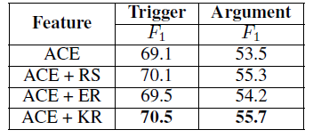
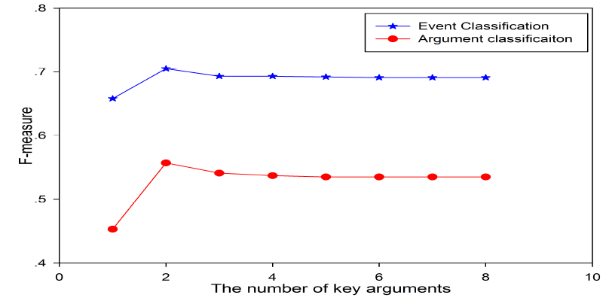
Experiments
Impact of Key Rate
ACE+KR achieve the best performance in both stages. This demonstrates the effectiveness of our KR methods
if k = 2, we will get 25,797 sentences labeled as people.marriage events and we will get 534 labeled sentences, if k = 3.

Slide 28
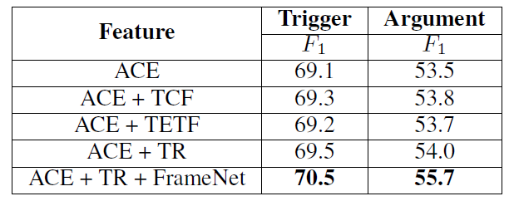
Experiments
Impact of Trigger Rate and FrameNet
Compared with ACE+TCF and ACE+TETF, ACE+TR gains a higher performance in both stages. It demonstrates the effectiveness of our TR methods.

Slide 29
Experiments
Impact of Trigger Rate and FrameNet
When we use FrameNet to generate triggers, compared with ACE+TR, we get a 1.0 improvement on trigger classification and a 1.7 improvement on argument classification

Slide 30
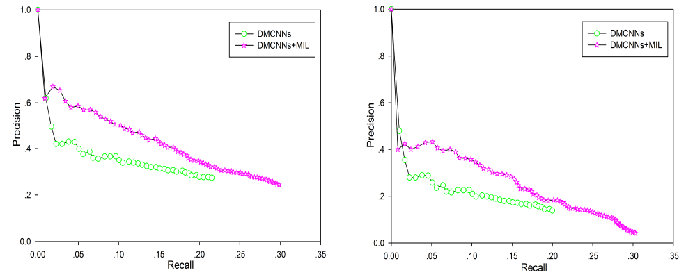
Experiments
Performance of DMCNN-MIL (Held-out Evaluation)
we hold out part of the Freebase event data during training, and compare newly discovered event instances against this held out data
Event classification
Argument classification

Slide 31
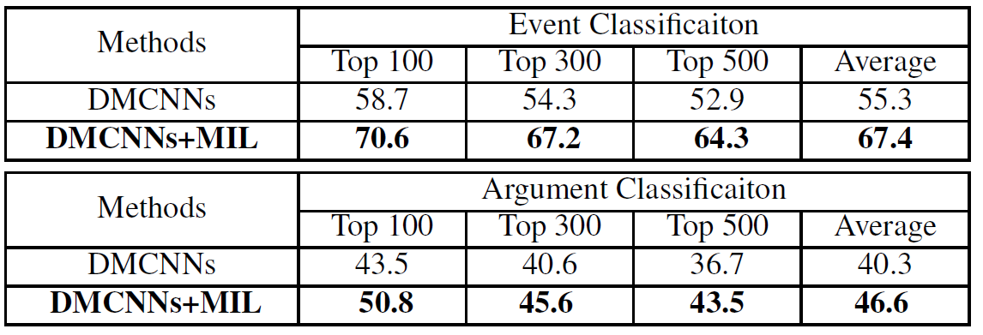
Experiments
Performance of DMCNN-MIL (Human Evaluation)
Because the incomplete nature of Freebase, held out evaluation suffers from false negatives problem.
we manually check the newly discovered event instances that are not in Freebase

Slide 32
Conclusion
we present an approach to automatically label data for large scale event extraction via world knowledge and linguistic knowledge.
The experimental results show the quality of our large scale automatically labeled data is competitive with elaborately human-annotated data.

Slide 33
Thanks
Email:
yubo.chen@nlpr.ia.ac.cn

