Slide 1
Idiom-Aware Compositional Distributed Semantics
Authors: Pengfei Liu, Kaiyu Qian, Xipeng Qiu, Xuanjing Huang
From: Fudan University (NLP Group)

Slide 2
Learn representations for long text spans
sentence
A set of words
Composition Function
Notes:
背景：从句子表示说起→ 合成函数有哪些？→ 这些合成函数足够好？ → 习语现象的出现给现有的合成函数提供了挑战

Slide 3
Typical Semantic Composition Functions
Non-parameterized Composition Function
Bag-of words (Wieting et al. 2016; Arora et al. 2017)
Parameterized Composition Function
Convolutional neural network
Recurrent neural network
X-RNN
Recursive neural network
Unsupervised models
Paragraph vectors (Le et al. 2014)
Skip-thought (Kiros et al. 2015)
VAE (Bowman et al. 2015)

Slide 4
Are these compositional models perfect ?

Slide 5
Idioms Impose Great Challenges for Representing the Semantics of Language
Three following properties of idioms:
Invisibility
Idiomaticity
Flexibility

Slide 6
Invisibility
Explanation: Idioms always disguise themselves as normal multi-words in sentences.
Challenge: It makes end-to-end training hard since we should detect idioms ﬁrst, and then understand them.
Examples: Boys finished with the wooden spoon after losing a penalty shoot out 5-4.

Slide 7
Idiomaticity
Explanation: Idioms are semantically opaque, whose meanings cannot be derived from their constituent words.
Challenge: Existing compositional distributed approaches fail due to the hypothesis that the meaning of any phrase can be composed of the meanings of its constituents. .
Examples: She will go bananas about your behavior.

Slide 8
Flexibility
Explanation: While structurally ﬁxed, idioms allow variations. The words of some idioms can be removed or substituted by other words.
Challenge: It’s hard to model.
Examples: She went bananas about your behavior.

Slide 9
What have we done in this paper ?
Propose an idiom-aware distributed semantic model to build representation of sentences on the basis of understanding their contained idioms
Integrate idioms understanding into a real-world NLP task instead of evaluating idiom detection as a standalone task.
Construct new real-world dataset covering abundant idioms with original and various forms.

Slide 10
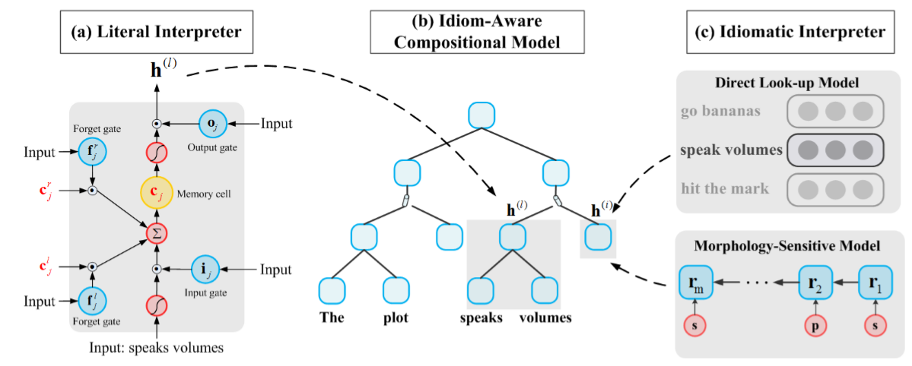
Overview of Our Model
Literal Interpreter
Idiomatic Interpreter
Idiom Detector

Slide 11
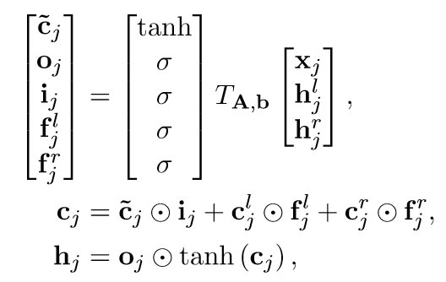
Overview of Our Model
Literal Interpreter

Slide 12
Overview of Our Model
Idiomatic Interpreter
Direct Look-Up Model
Morphology-Sensitive Model

Slide 13
Overview of Our Model
Idiom Detector
The detector outputs a scalar α to determine whether the meaning of a phrase is literal or idiomatic.

Slide 14
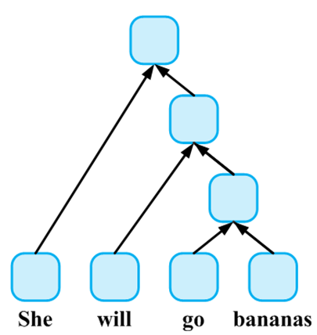
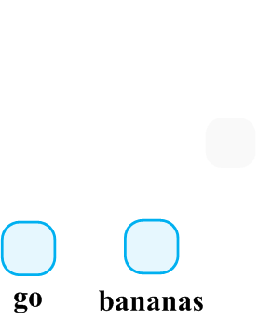
Intuitive Interpretation of Our Model

Slide 15
Evaluation Task: Idiom-enriched Sentiment Classification
Reason:
Most of idioms are non-compositional phrases.
Idioms typically imply an affective stance toward something rather than a neutral one.[Williams et al., 2015]
The error analysis of sentiment classification results reveals that a large number of errors occur when idioms are used to express sentiment[Balahur et al., 2013].

Slide 16
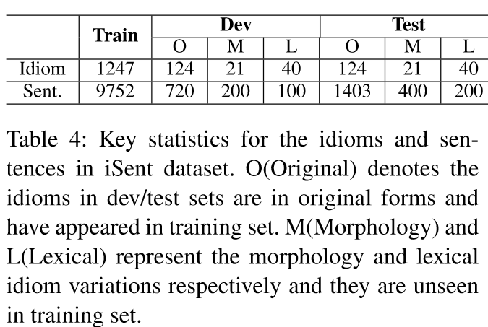
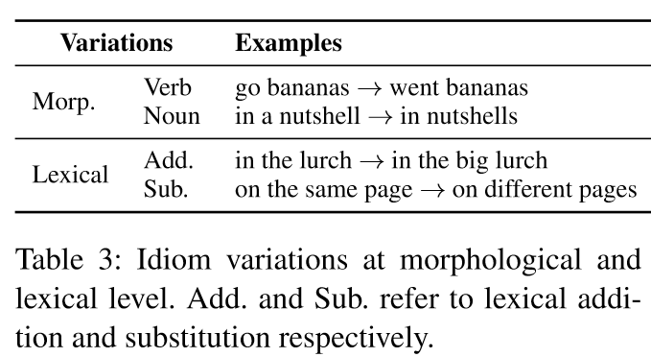
Evaluation Task: Idiom-enriched Sentiment Classification
New Dataset:

Slide 17
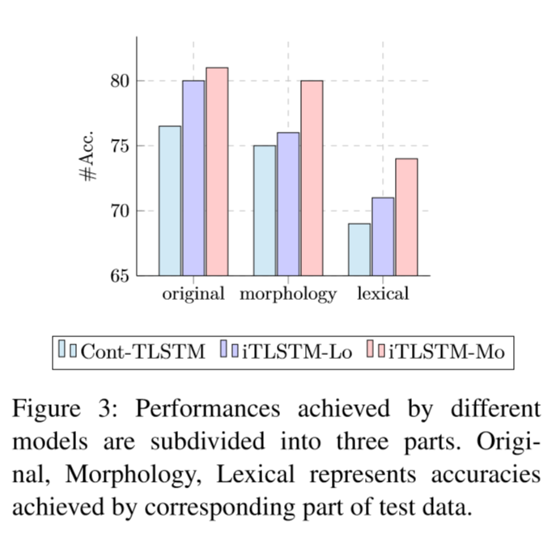
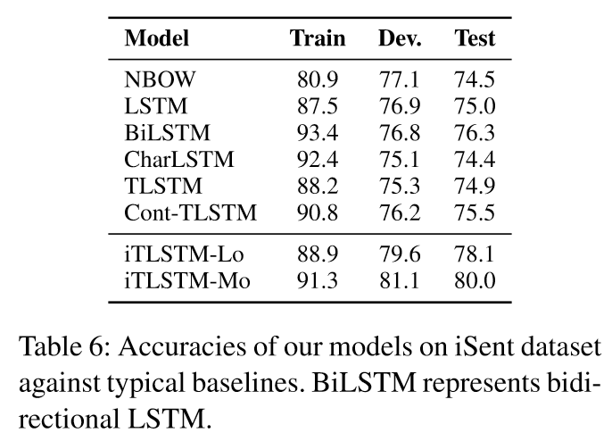
Results

Slide 18
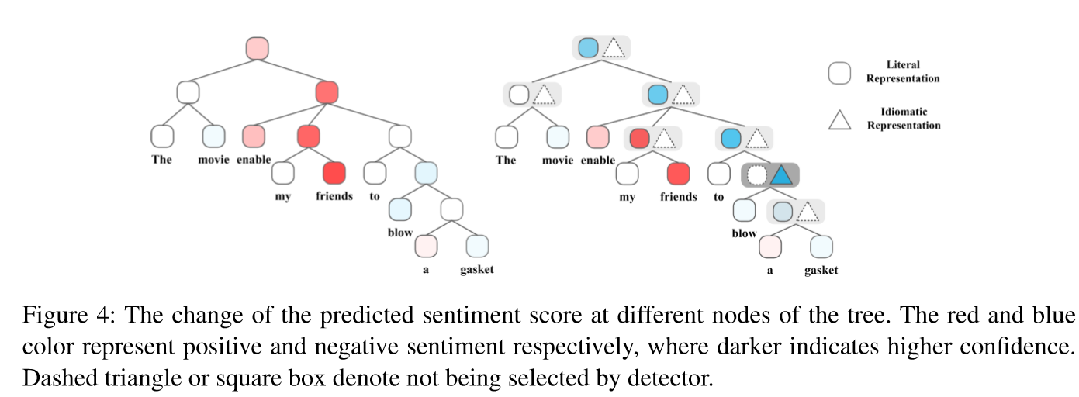
Analysis

Slide 19
Conclusion
We integrate idioms understanding into a real-world NLP task instead of evaluating idiom detection as a standalone task.
We construct a new real-world dataset covering abundant idioms with original and various forms.
In future work, we would like to investigate more complicated idiom-enriched NLP tasks, such as machine translation.

